Slide 1


Coffee Cultivation in India
India is one of the world's leading producers of high-quality coffee, with a long history of coffee cultivation in its southern regions. The country's diverse climate and geography provide ideal conditions for growing various coffee varieties.
by pal gandhi

Slide 2
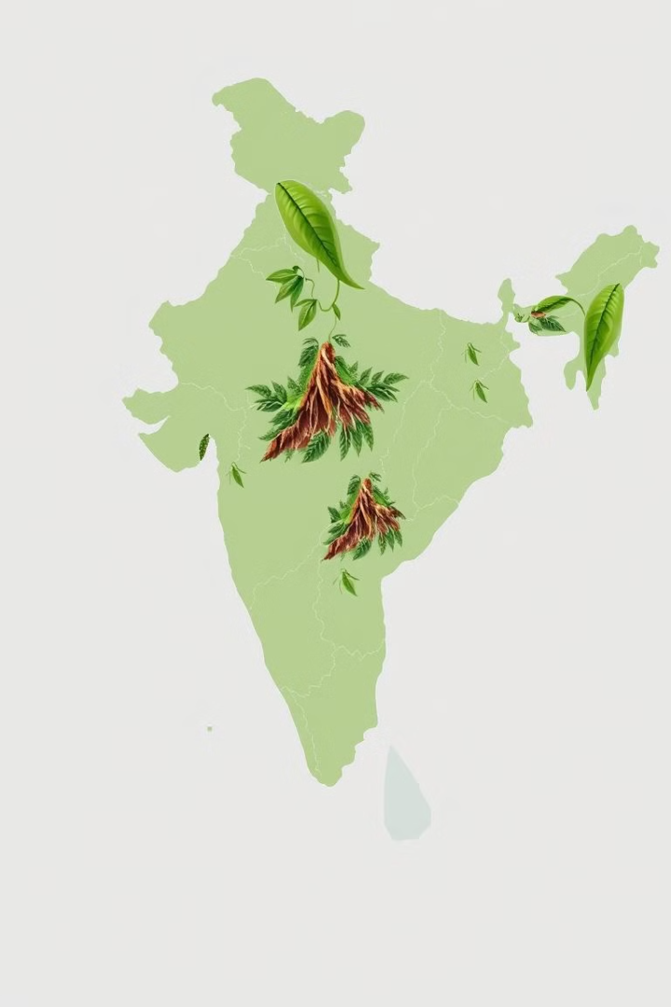
India's Climate and Geography Conducive for Coffee
1
Tropical Climate
2
Elevation Ranges
India's tropical climate, with distinct wet and dry seasons, is well-suited for coffee cultivation.
The country's diverse terrain, with elevated regions in the south, offers a range of microclimates for different coffee varieties.
3
Fertile Soils
The rich, well-drained soils in the major coffee-growing regions provide the necessary nutrients for optimal plant growth.

Slide 3
Major Coffee Growing Regions in India
Karnataka
Kerala
Tamil Nadu
India's largest coffee producer, known for its robust Arabica and Robusta varieties.
Famous for its aromatic, mellow-flavored Robusta coffee, grown in the Western Ghats region.
Produces both Arabica and Robusta coffee, with a focus on high-quality, specialty beans.

Slide 4
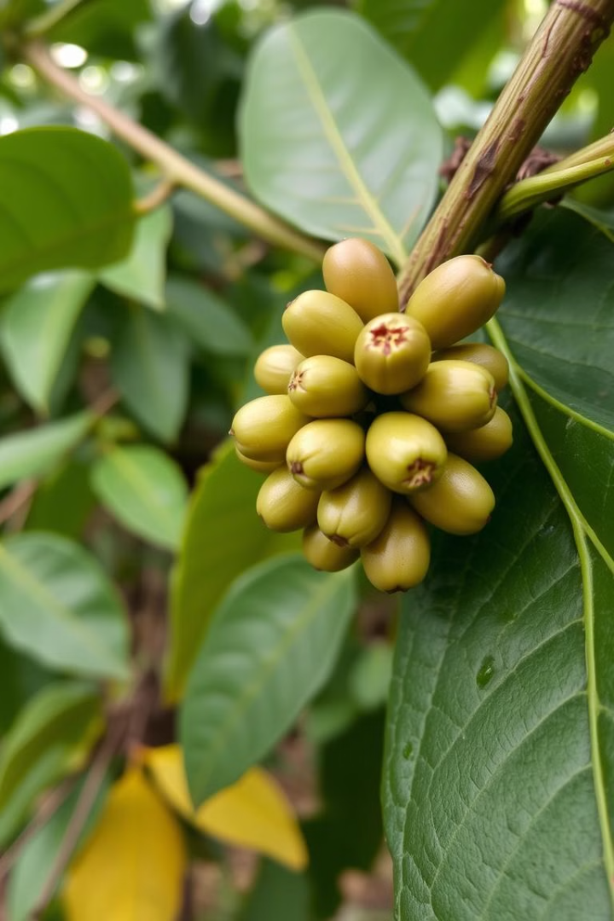
Cultivation Practices
Shade-Grown
Organic Methods
Coffee plants are often grown under the shade of taller trees, which helps regulate temperature and soil moisture.
Many Indian coffee growers utilize organic farming techniques, minimizing the use of synthetic fertilizers and pesticides.
Intercropping
Sustainable Practices
Coffee plants are sometimes grown alongside other crops, such as spices or fruit trees, to diversify and maximize land usage.
Indian coffee growers are increasingly adopting sustainable practices to preserve soil health and biodiversity.

Slide 5
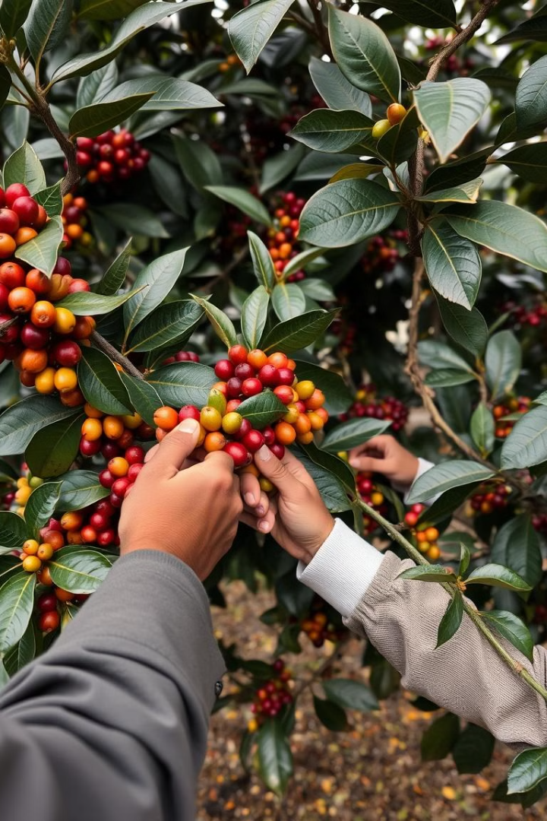
Harvesting Techniques
1
Cherry Picking
Coffee cherries are hand-picked by skilled workers, ensuring only the ripest fruits are harvested.
2
Processing
The harvested cherries undergo various processing methods, such as wet or dry processing, to extract the coffee beans.
3
Drying and Sorting
The processed beans are then carefully dried and sorted to ensure consistent quality and size.

Slide 6
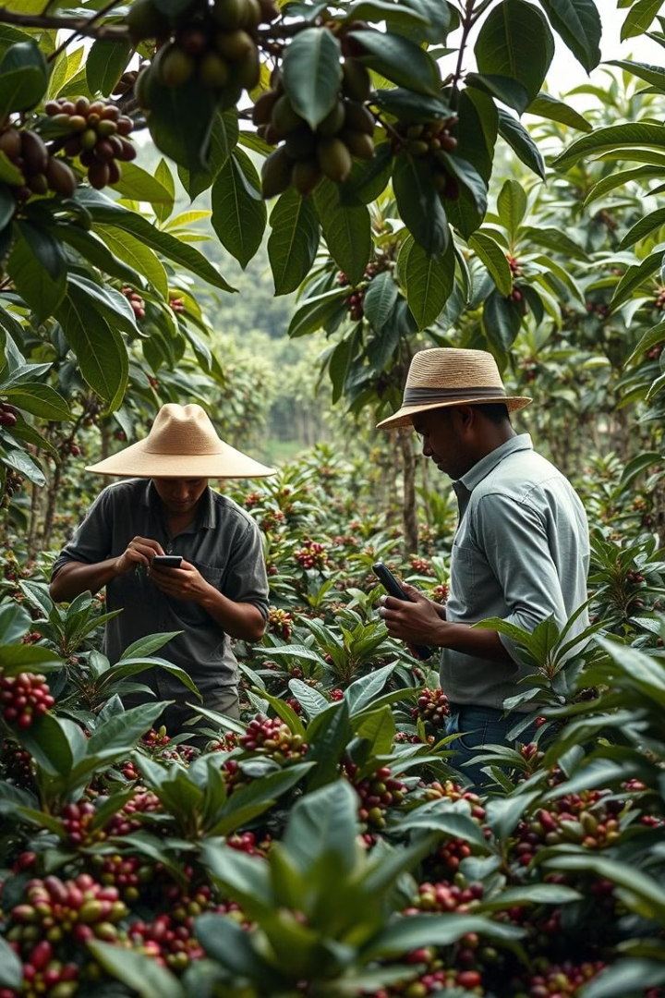

Challenges Faced by Indian Coffee Growers
Climate Change
Pest Infestations
Erratic weather patterns and unpredictable rainfall can disrupt crop yields and quality.
Coffee plants are susceptible to various pests and diseases, which can significantly impact production.
Market Volatility
Labor Shortages
Fluctuating global coffee prices and changing consumer trends pose challenges for growers.
Attracting and retaining skilled workers for manual tasks like harvesting can be difficult.

Slide 7





Health Benefits of Coffee
Antioxidants
Coffee is rich in antioxidants that can help protect against various health issues.
Cognitive Function
Caffeine in coffee can improve mental alertness, focus, and cognitive performance.
Cardiovascular Health
Moderate coffee consumption may help reduce the risk of heart disease and stroke.
Diabetes Prevention
Studies suggest that coffee intake may lower the risk of developing type 2 diabetes.

Slide 8

Opportunities for Growth and Export Potential
Growing Domestic Demand
India's expanding middle class is driving increased domestic consumption of coffee.
Specialty Coffee Exports
Indian coffee growers are focusing on high-quality, specialty beans for the export market.
Sustainable Certifications
Indian coffee is increasingly certified as organic, fair trade, and environmentally sustainable.
Diversification and Value-Addition
Opportunities for Indian coffee growers to explore new products, such as coffee-based beverages and food items.

Slide 9
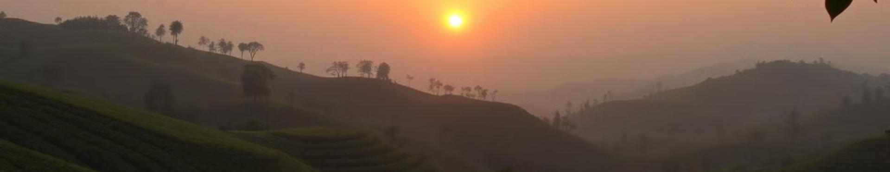
Conclusion
India's coffee industry has a rich history and bright future, with its diverse climate, skilled growers, and growing domestic and international demand. By embracing sustainable practices and capitalizing on opportunities, Indian coffee can continue to thrive and contribute to the global coffee landscape.

